Slide 1

Presented by- Sankalp Mahapatra Internship-29

Slide 2
TABLE OF CONTENTS
Introduction
Why is Customer retention important
Problem Statement
Motivation for the Problem Undertaken
Exploratory Data Analysis (EDA)
Conclusion

Slide 3
INTRODUCTION
Customer retention is a business’s ability to keep existing customers and continue to generate revenue from them. Companies use different tactics to convert first-time buyers into repeat shoppers. In other words, customer retention allows a business to increase the profitability of an existing customer and maximize their lifetime value (LTV).
Think of customer retention as a process where a business aims to convince existing customers to keep purchasing their products or services. Since a customer has already made a purchase, it’s different from lead generation, which is the effort involved in capturing contact information of businesses or individuals who are likely to buy a product or service.
Instead, customer retention is focused on existing customers. The goal is to increase repeat purchases by building customer loyalty through excellent customer service, product value and a distinct advantage over similar products or services.

Slide 4
Why is Customer retention important ?
Customers tend to move on for a myriad of reasons, which can include poor customer service, too much friction in the buying process and a lack of perceived value. This is why it’s a good idea to map out the customer journey to know where the leaks are. It’s also a best practice to solicit customer feedback and incorporate it into the company’s larger plans.
Customer retention is vital in driving repeat purchases and on-going value from your customer base. One oft-cited rule of thumb is that it costs five times as much to acquire a new customer as it does to retain an existing customer. Two of the most important factors in improving customer retention is understanding your customers’ satisfaction and loyalty. Businesses also need to understand any operations that may turn off potential and existing customers, such as slow or poor customer service or a faulty product.

Slide 5
Problem Statement
Customer satisfaction has emerged as one of the most important factors that guarantee the success of online store; it has been posited as a key stimulant of purchase, repurchase intentions and customer loyalty. A comprehensive review of the literature, theories and models have been carried out to propose the models for customer activation and customer retention. Five major factors that contributed to the success of an e-commerce store have been identified as: service quality, system quality, information quality, trust and net benefit. The research furthermore investigated the factors that influence the online customers repeat purchase intention. The combination of both utilitarian value and hedonistic values are needed to affect the repeat purchase intention (loyalty) positively. The data is collected from the Indian online shoppers. Results indicate the e-retail success factors, which are very much critical for customer satisfaction.

Slide 6
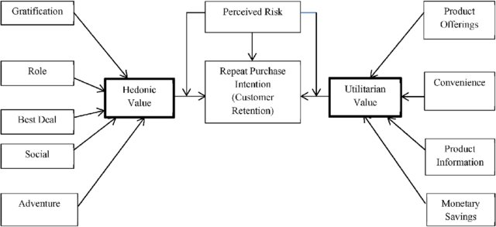
Utilitarian value: Utilitarian value is an objective value which provides some functional benefits to the consumers and helps consumers to accomplish practical tasks.
Hedonistic value: Hedonistic value is subjective (Psychological) value which provides an experiential satisfaction. In other words, the immediate psychological gratification that comes from experiencing some activity or from consumption of a product.

Slide 7
In the above diagram, we can see that the Repeat Purchase Intention (customer Retention) basically our Customer Retention strategy relies on Hedonic value and Utilitarian value. Also, we see that there are perceived risks affecting the purchase and re purchase intentions of our customers. The Hedonic value has 5 major parts such as gratification, role, best deal, social aspect and adventure feeling criterions. Where as in Utilitarian value we have product offerings, convenience, product information and monetary savings.

Slide 8
Motivation for the Problem Undertaken
Our main motivation for undertaking this project was to find out how many people are shopping from e commerce websites online. There are also local stores available in the market which people can directly visit and get the things of their need, but here we will find out how are the e-commerce giants like flipkart, amazon, snapdeal etc are retaining the online traffic so that customers would buy things of their need from them . Here we are provided with a dataset which contains responses from different customers of e commerce websites and their age , sex and some other information are also present.

Slide 9
Benefits of Customer Retention
The main benefit of customer retention is the ability to maximize the amount of money you can extract from each customer. There are also other benefits including the following:
Increased profits: Many companies generate the majority of their revenue from existing customers—61% of SMBs said this was the case, per a BIA/Kelsey report—so focusing on this part of your business should be the priority. It will not only increase your revenue, but also your business’s profitability.
Lower costs: Retaining an existing customer is anywhere from 5-25 times cheaper than acquiring a new one, according to Bain & Company, so it’s a much more cost-effective strategy in the long run.
Increased average order value (AOV): Repeat customers tend to spend more over time while increasing their average order value. That’s why just a 5% increase in retention rate can lead to profits growing 25-95%, per Bain & Company. And loyal customers are 23% more likely to buy again than others, according to a Gallup study.
Acquire brand ambassadors: Word of mouth is one of the best ways to grow your business organically. The more loyal your customers, the more likely that they’ll share positive experiences and recommend your company to others.

Slide 10
When to Focus on Retention
The maturity of your business will determine whether you need to focus on customer retention. For instance, if your company just launched, you should focus on customer acquisition, as there are no existing clients to retain. The focal point at that stage should be developing strategies that will cultivate your initial customer base. That’s because you’re not getting any sales or customers, making it a moot point in trying to retain them. Tactics can include creating co-branded content, content produced by your business and a non-competitor, or creating a paid ad campaign.
But it doesn’t mean you can plant the seeds. Actions such as engaging with consumers and making the purchase process as frictionless as possible helps a business to gain traction. As this happens, there will be more data to look at what’s working—perhaps start tactics such as retention email campaigns or surveys. That way your business is working towards encouraging existing and past customers to make additional purchases.
Once you’re more established, you can incorporate more customer retention tactics—making it more of a priority than customer acquisition—as you start to generate more consistent sales. As your sales grow at a steady rate and you have a decent-sized customer base, you can shift more time and attention to your customer retention efforts. At this stage, things like loyalty or referral programs make sense, as you’ll have a steady (and hopefully loyal) customer base to draw from.

Slide 11
5 Strategies to Improve Customer Retention
Here are some practical ideas for improving customer retention:
Engage with customers: Look at your marketing channels and identify the best ways to engage with your clients. Do they respond best to social media, email marketing, online events or something else? Let customers weigh in on upcoming products and services, so they feel like they’re part of the brand.
Reduce friction in the purchase process: The fewer obstacles or challenges customers face when purchasing your product or service, the better. When it comes to e-commerce, fast page load times and a fast, simple checkout experience is critical. In a store, eliminate friction by making sure a staff member is always available to help a customer when they’re ready to check out.
Improve customer support: Offer multiple ways for customers to reach you. This can include live chat on your website, a dedicated telephone number, email, social media and a comprehensive FAQ page online. Additionally, you want to ensure fast response rates. Training your staff well and measuring their performance with benchmarks will help you meet customer expectations for communication.
Create a community: Having exclusive membership programs or forums where your company representatives and customers can interact with each other will help generate more brand loyalty and buzz. Other ideas include giving discount codes to loyal customers and creating referral programs that offer current clients an incentive.
Start a loyalty program: Loyalty programs can be a great way to motivate existing customers to make additional purchases and at a higher frequency. Ensure that your loyalty program has rewards that existing customers would find valuable, like free products or significant discounts.

Slide 12
Insights of the Data
This data is collected from the Indian online shoppers. Our Dataset consists of reviews and feedbacks of customers on 5 top Indian e commerce websites like Amazon, Flipkart, Snapdeal, Myntra and Paytm.
Questions are formed on the basis of brand strength, brand empathy or commitment, overall customer satisfaction and perceived value for money with intention to recommend.
Results indicate the success factors which are very much critical for customer satisfaction and retention in e commerce websites.

Slide 13
Exploratory Data Analysis (EDA)
First I have imported all the libraries in jupyter notebook and then I have imported the data from the excel file.
Then as the number of columns are more than 70 so all the columns are not visible after using head() method. So I have used set_options() method to display all the columns and rows.
Then I have printed the number of rows and number of columns using data.shape. and after that I have checked for the null values.
To get a more clear view about the null values I have used heatmap plot.
I have found out that there was no null values present in the dataset.
Then I have printed the number of columns and I have observed that the column names were very big so I have renamed the columns.

Slide 14
After that I have checked for different types of data types present in the dataset and I have found out that there are 70 columns having object(string) datatype values. We need to change them into numerical values.
Then I have used describe() method to know about the statistics of the dataset. In this dataset only one column with continuous values is present.
Then I have found out the number of unique values in each column.
After that I have find out the type of catagorical values in each column for selecting the proper encoding technique.
Then I have removed the duplicate values in the above columns.
After that I have plot the value counts of all the categorical columns using countplot.

Slide 15
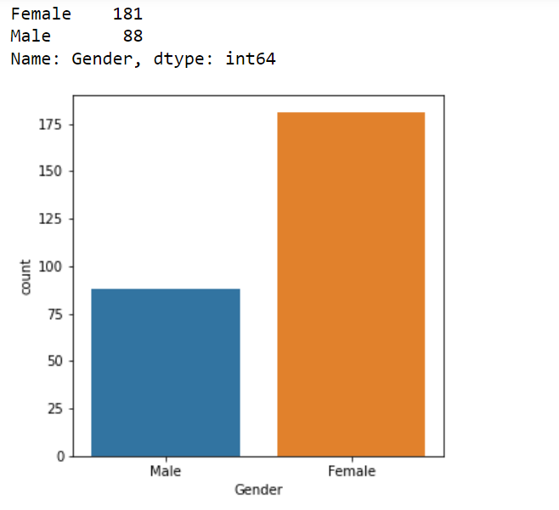
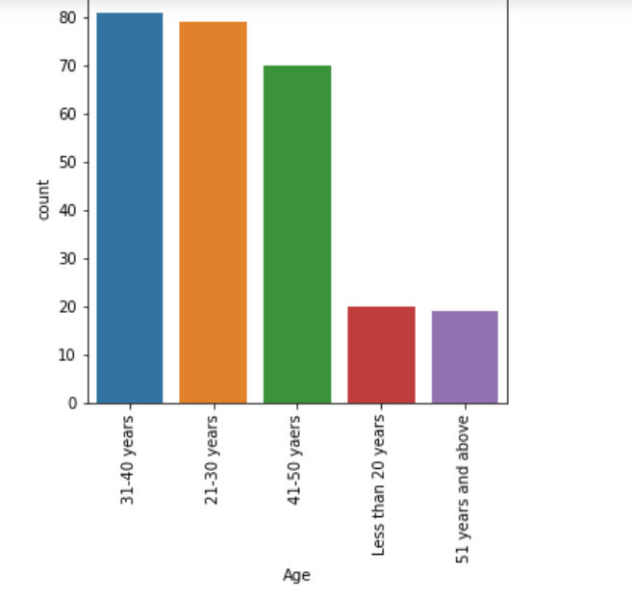
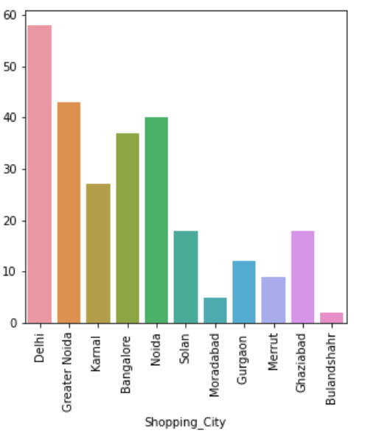
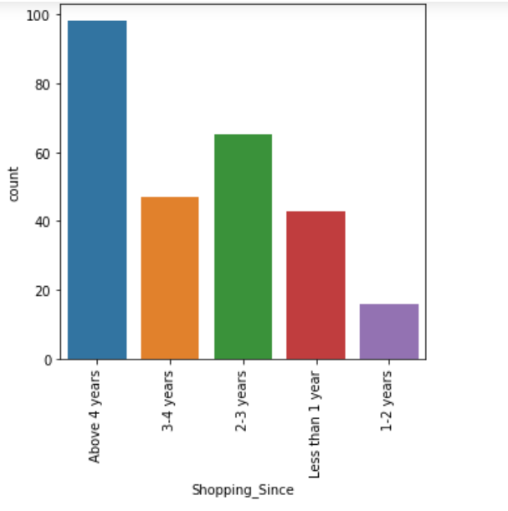

Slide 16
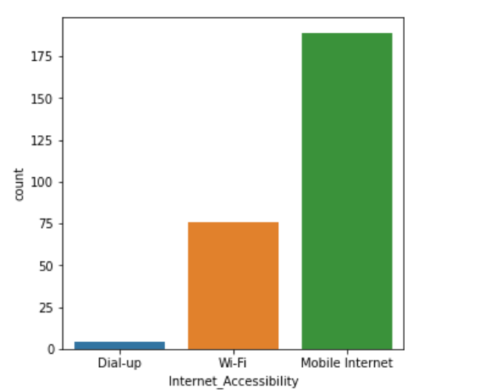
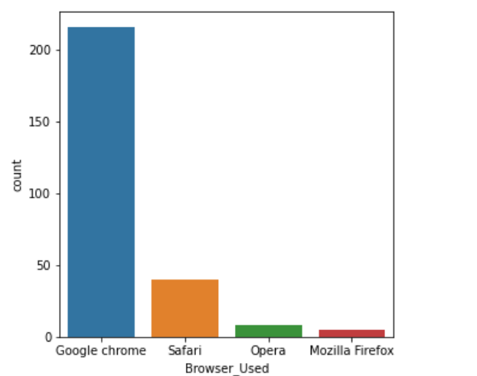
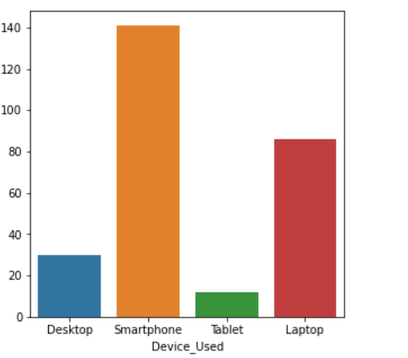
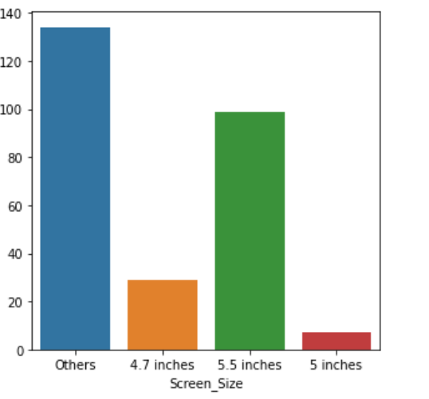

Slide 17
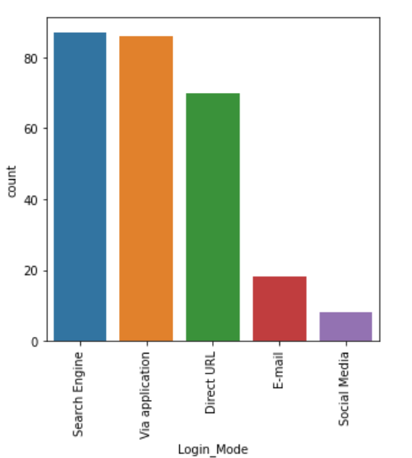
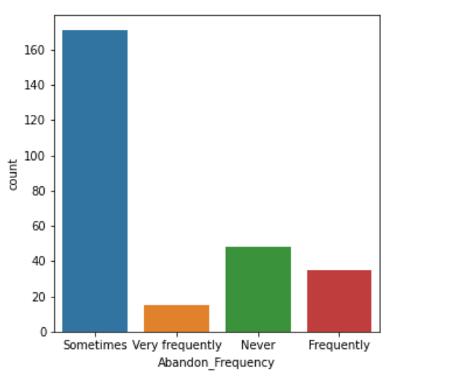
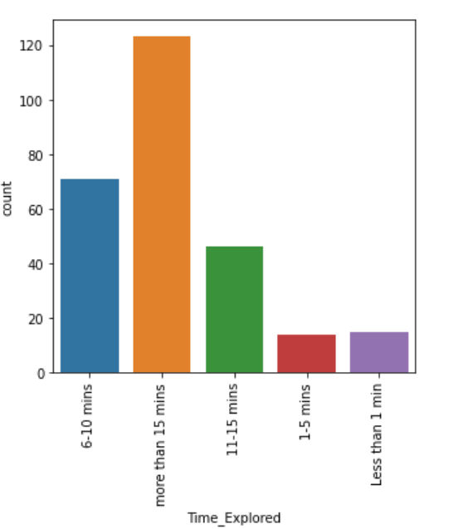
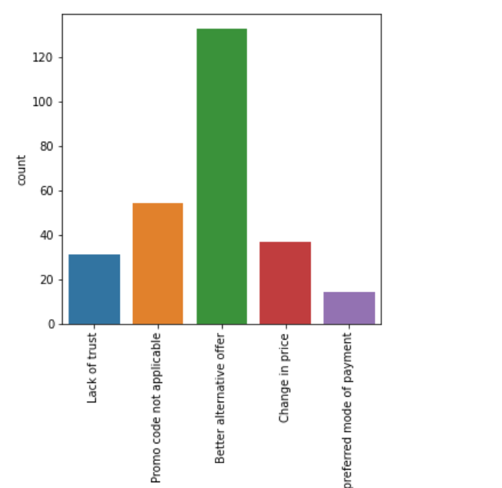

Slide 18
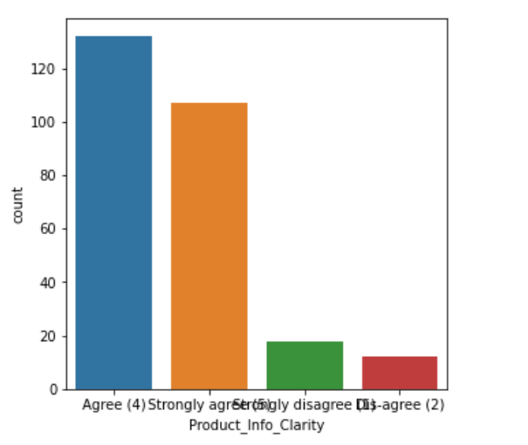
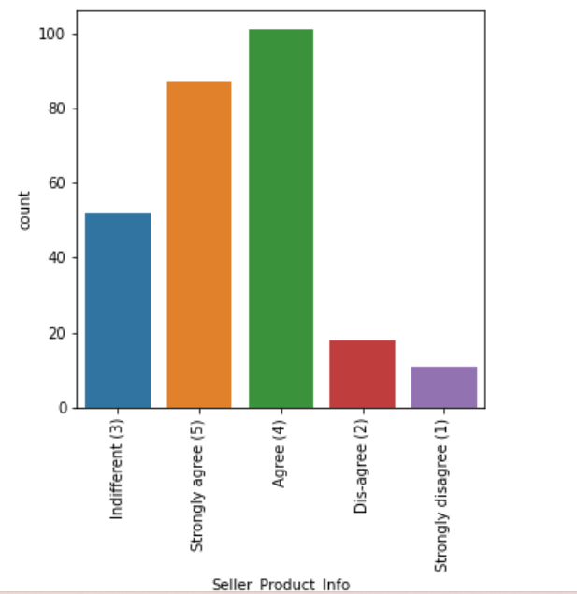
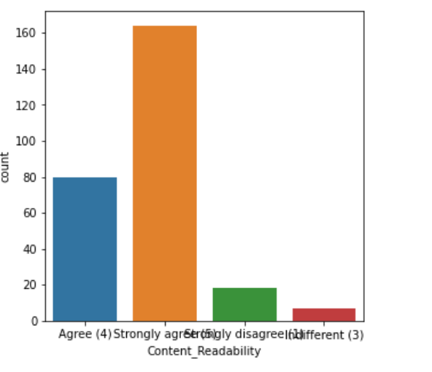
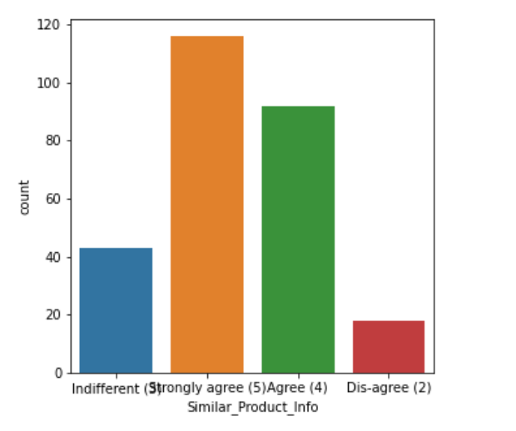

Slide 19
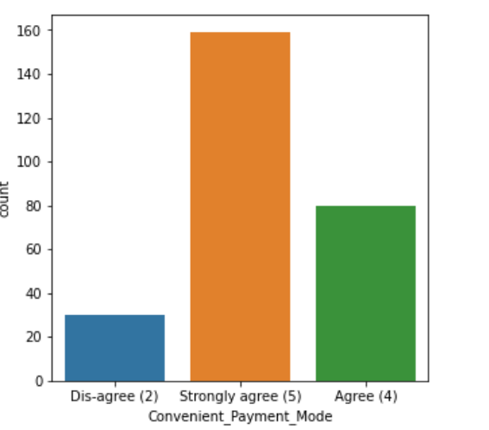
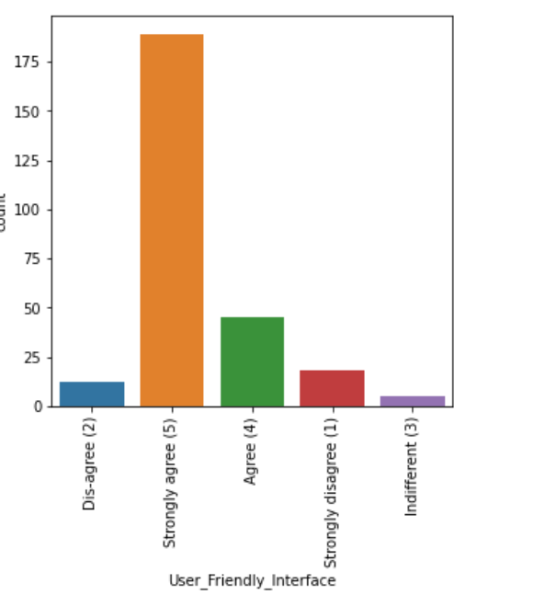
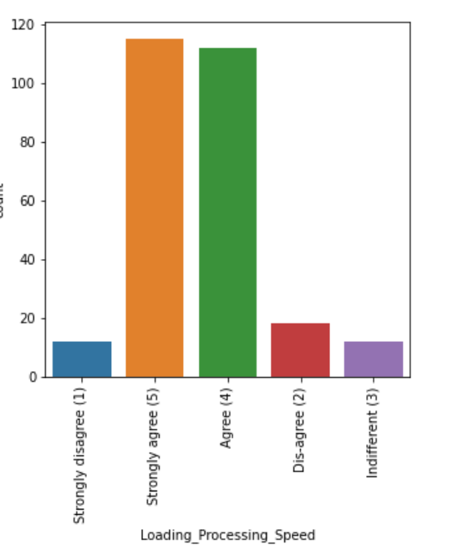
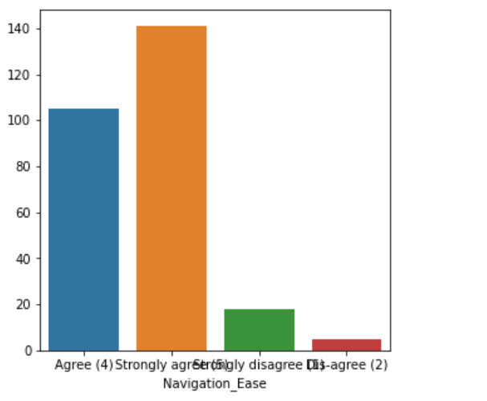

Slide 20
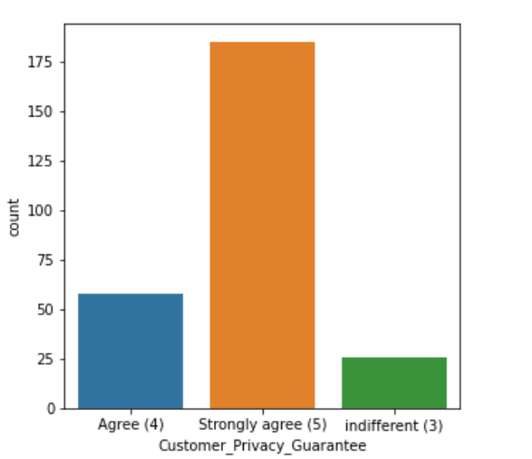
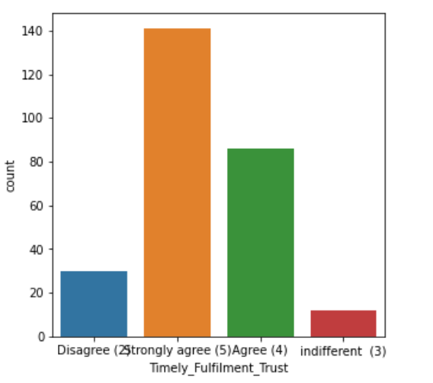
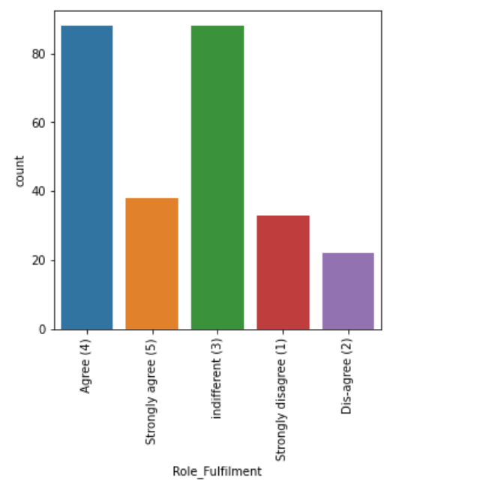
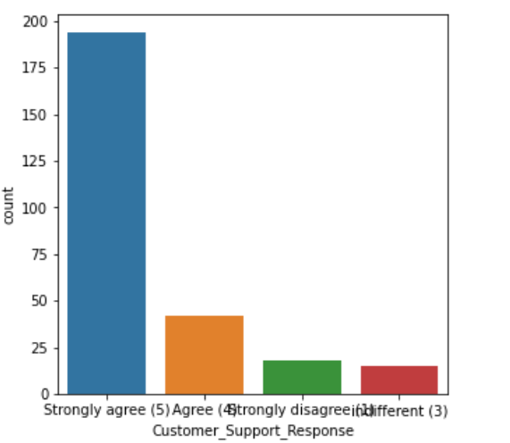

Slide 21
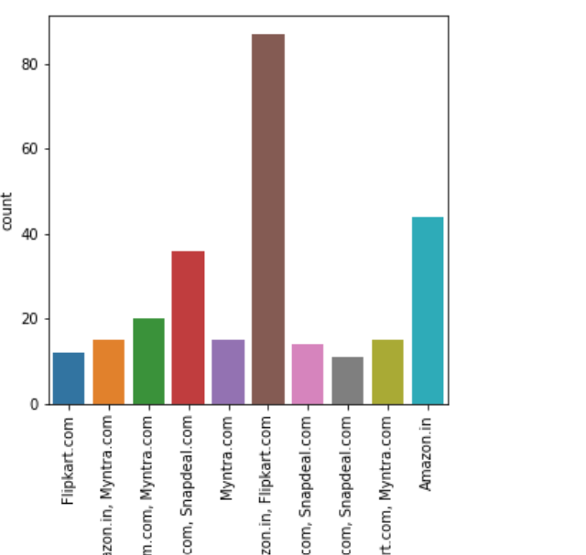
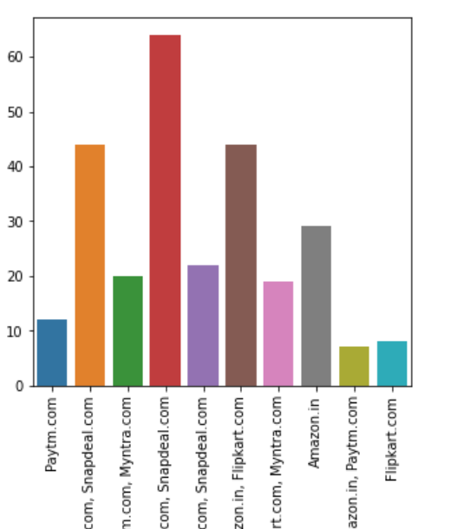
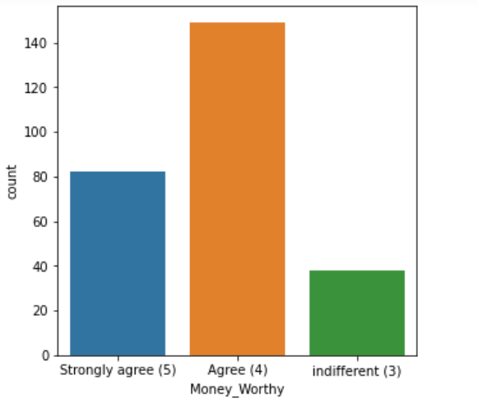
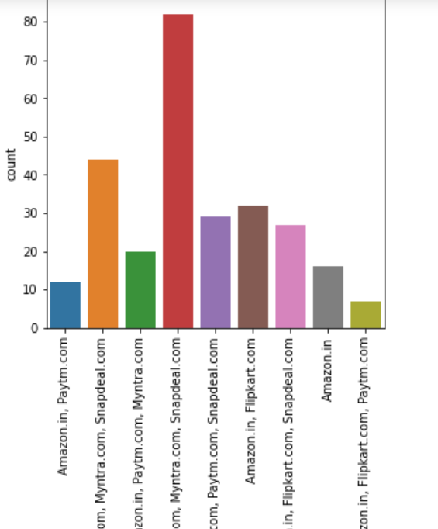

Slide 22
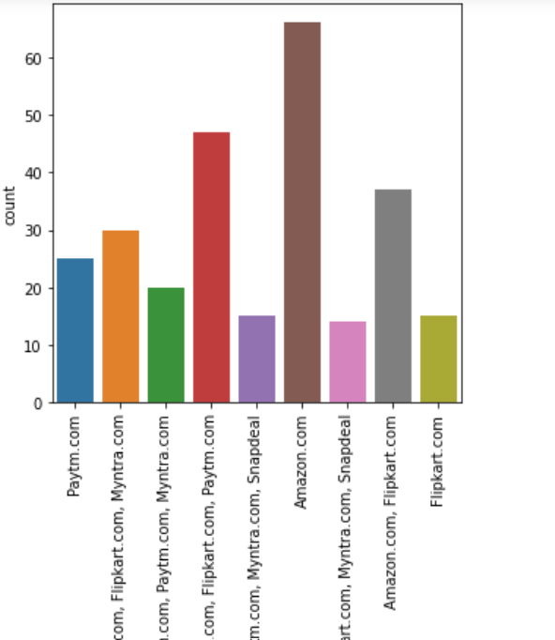
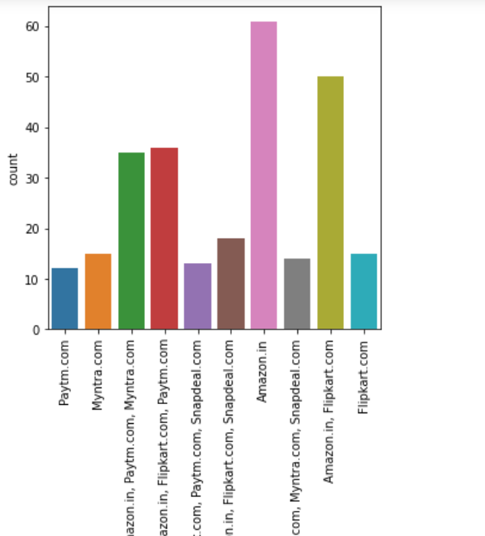
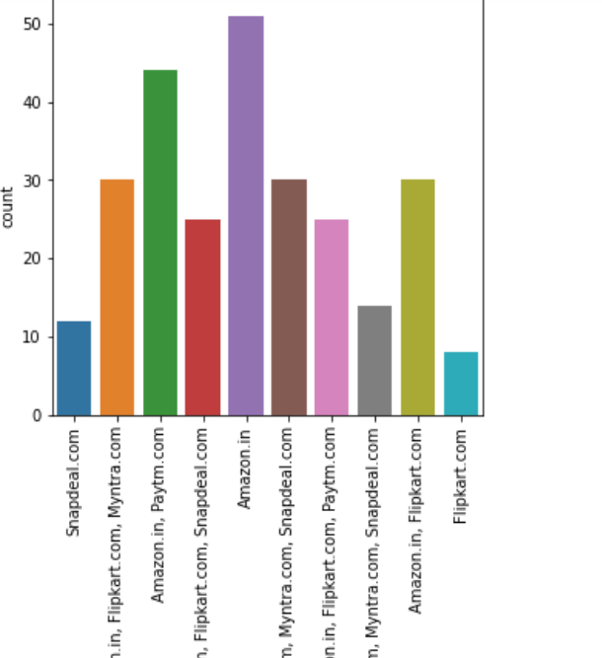
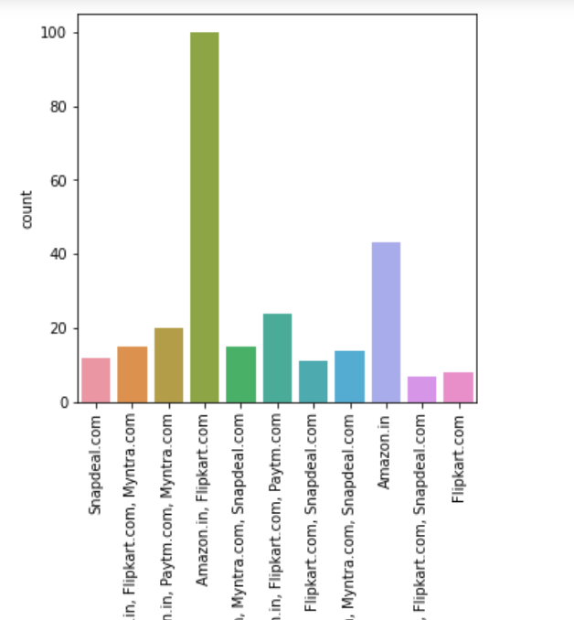

Slide 23
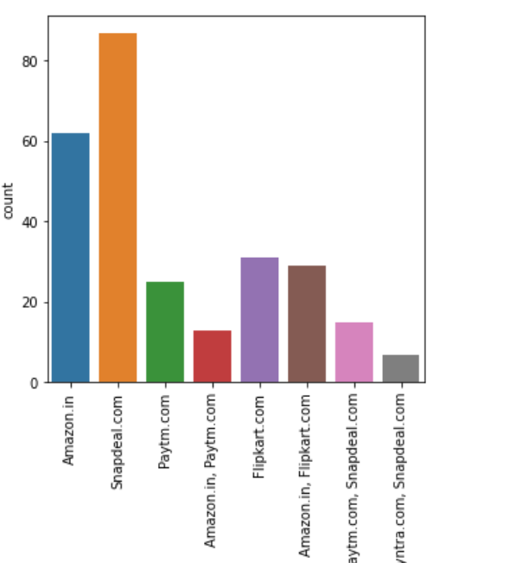
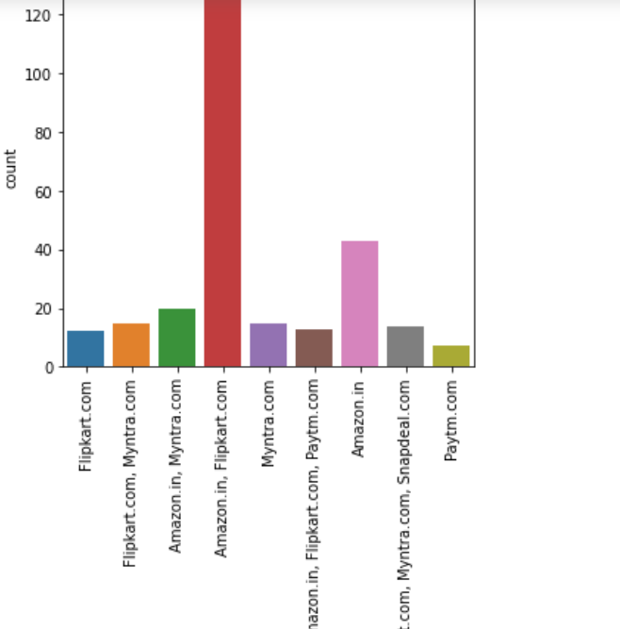

Slide 24
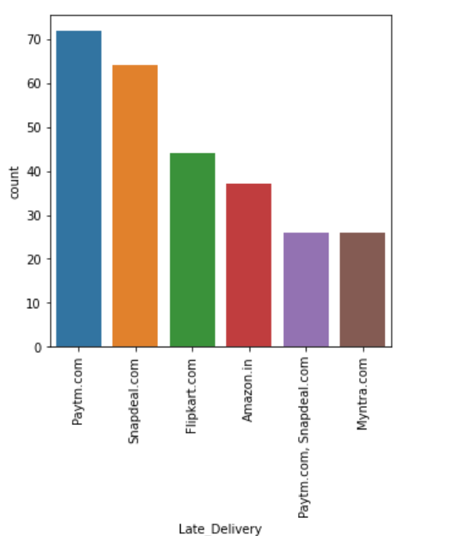

Slide 25
Observations from the Countplots
There were more female customers than male customers.
People in age group od 21 to 30 years are more active on e commerce sites.
Most of the customers from the city Delhi, Greater Noida, Noida and Bangalore are used to shop onine and the shopping count is high in these cities.
Most of the customers found shopping online for more than 4 years and the count is high for the same.
In last 1 year, most of the customers started purchasing online.
Most of the customers used Smartphone device to access the online shopping.

Slide 26
The count is high for others mobile screen size.
Most of the customers used Google chrome to access the website.
Most of the customers used Search Engine and Via application to reach the online retail store.
Many customers took more than 15 mins before making the purchase decision.
Around 133 customers abandoned their bag due to some better alternative offer.
Around 77% of the customers agreed that the information on similar product to the one highlighted is important for product comparison.
About 70% of the customers agreed that complete information on listed seller and product being offered is important for purchase decision.

Slide 27
88.84% of the customers agreed that all relevant information on listed products must be stated clearly and only 11% of the customers disagreed with it.
91% of the customers agreed that ease of navigation in website helps them more.
Most of the customers agreed that they have no issues with the loading and processing speed.
87% of the customers agreed with user friendly website interface.
84% of the customers trusted that the online retail store will fulfill its part of the transaction at the stipulated time.
83% of the customers agreed that shopping online is convenient and flexible and 12% of the customers are indifferent which means either they are agreed to this or disagreed and only 5% of the customers completely disagreed with it.

Slide 28
Most of the customers agreed to offering a wide variety of listed product in several category and the count is high for the same.
Around 86% of the customers would like to have provision of complete and relevant product information in the online shopping website.
47% of the customers agreed that shopping on the website helps them fulfilling certain roles and 33% of the customers are in confusion whether to agree or disagree and only 20% of the customers disagrees with it.
Most of the people shopped from Amazon.in, Flipkart.com, Paytm.com, Myntra.com, Snapdeal.com companies and they think that it is easy to use website or applicatiion in these companies.
Amazon.in and Flipkart.com have high visual appealing web-page layout compared to others.
48% of the customers says that amazon and flipkart shows wide variety of products in their shopping websited compared to other websites.

Slide 29
37% of the customers liked amazon and flipkart in displaying complete and relevant information of the products.
Around 51 customers says that Amazon.in is the fast loading website and application and they liked it.
The count is high for amazon followed by amazon and flipkart which means most of the customers liked the reliability of website or application in amazon and flipkart.
Most of the customers likes Amazon's quickness to complete the purchase followed by Flipart's and only few of the customers likes Myntra website.
In Amazon and flipkart websites there are several payment options available compared to the other shopping websites.
Most of the customers liked Amazon's delivery speed.
Most of the customers trusts amazon followed by flipkart in terms of keeping the privacy of their data information

Slide 30
The count is high for the customers who belives that amazon website keeps their finanacial information secret.
Most of the customers believed that Amazon has perceived trustworthiness comapared to others.
Most of the customers like Amazon inerms of presence of online assistance through multi-channel followed by flipkart,Myntra and snapdeal.
Most of the customers agreed that Amazon takes longer time to get logged them in.
Customers believes that Amazon and flipkart takes longer time in display the graphics and photos in sales period.
Customers says that Myntra and paytm have late declaration of price in promotion/sales period compared to others.

Slide 31
Also Myntra and paytm takes longer page loading time.
Snapdeal.com has limited mode of payment on most products followed by Amazon.in.
In terms of time taken in product delivery Paytm has highest count followed by Snapdeal.com.
Most of the customers disliked change in website/Application design on amazon followed by paytm.
Most of the customers disliked frequent disruption when moving from one page to another on amazon, Myntra and snapdeal.
Most of the customers believes that Amazon and flipkart website are as efficient as before.
Most of the customers would like to recommend amazon to a friend.

Slide 32
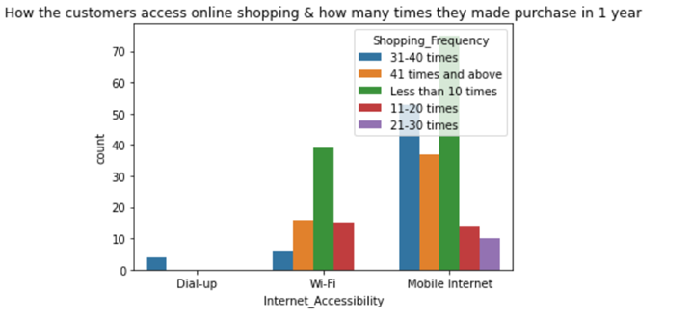
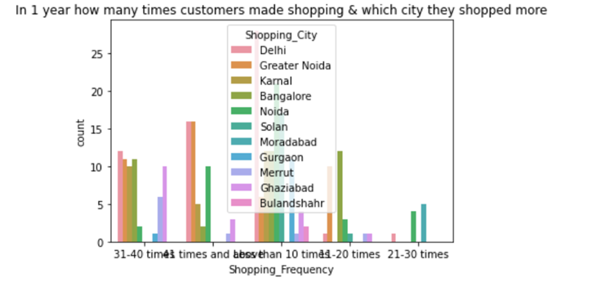
I have also plotted some more plots to k now more about the dataset.

Slide 33
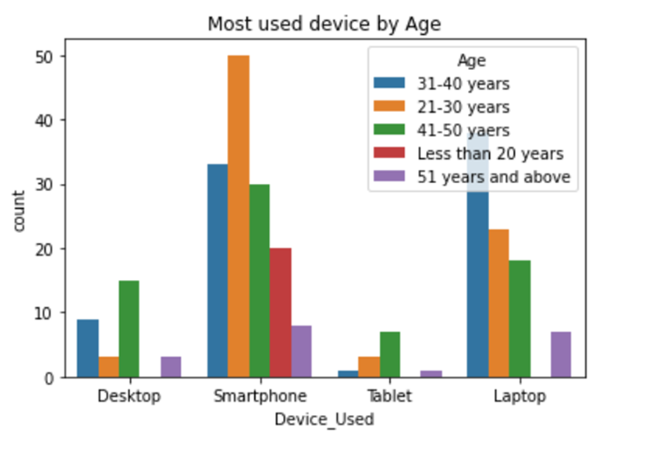
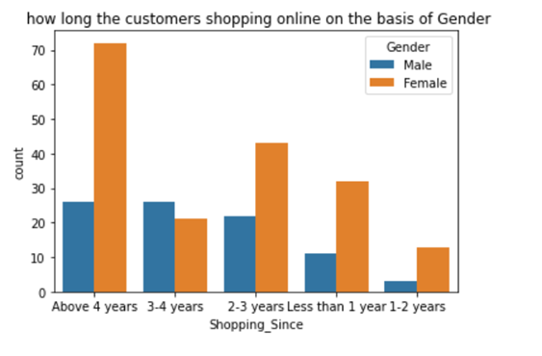

Slide 34
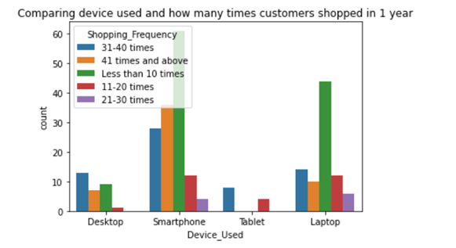
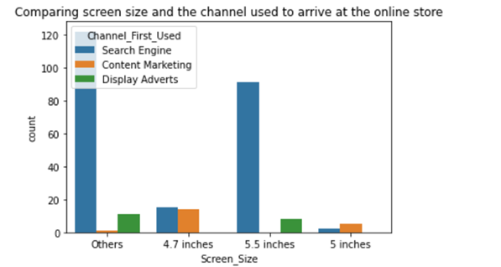

Slide 35
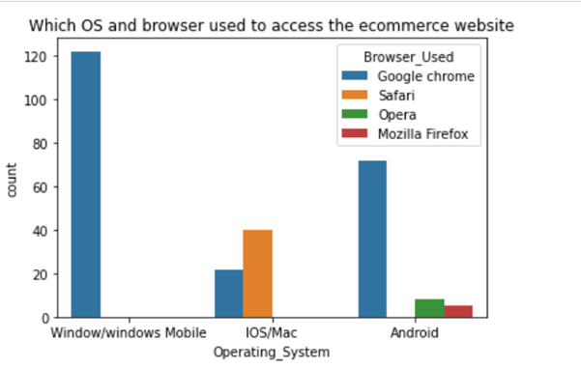
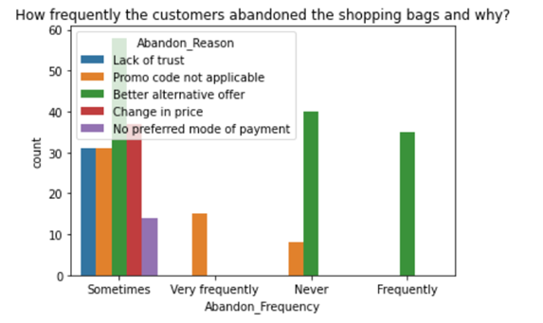

Slide 36
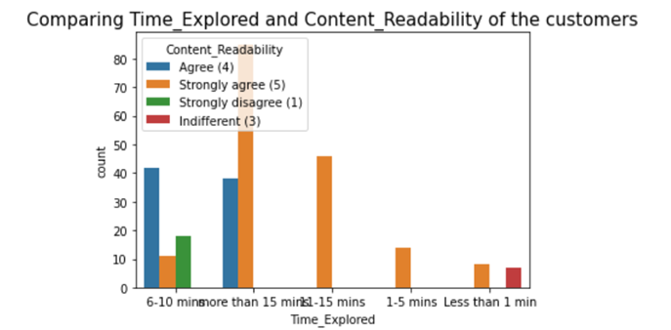
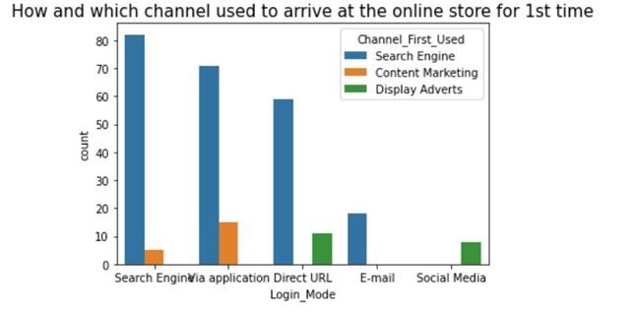

Slide 37
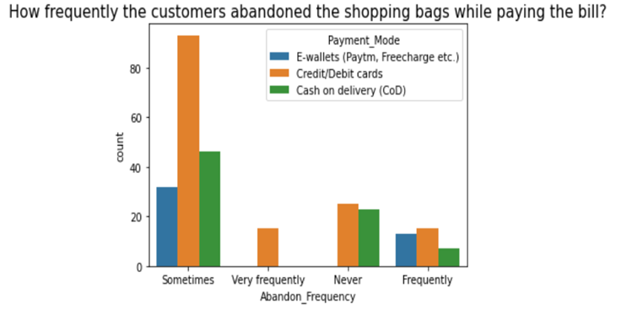
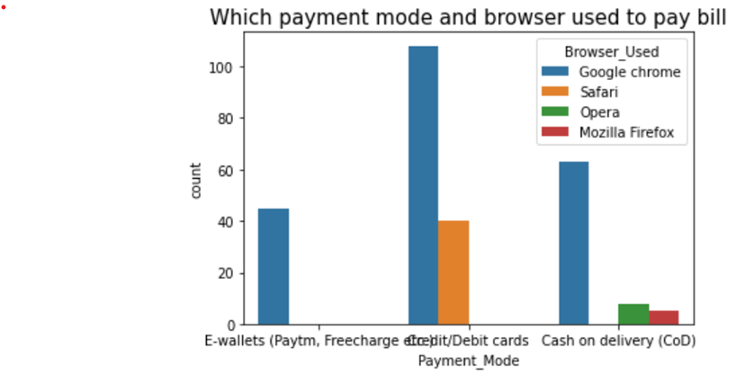

Slide 38
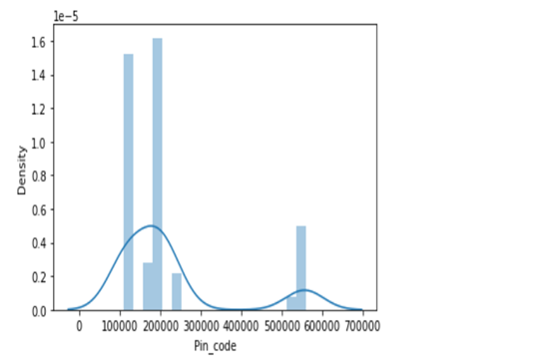
I have converted the dataset into numerical and categorical columns. And then I have used LabelEncoder to encode the categorical columns.
Then I have checked the distribution of the columns having continuous data.

Slide 39
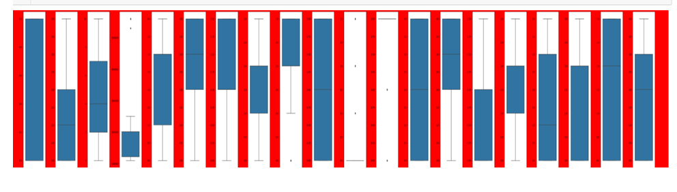
The data was found to be normally distributed in the Pin_code column and I have observe a little skewness in the right side. So then I have find out the outliers by using box plots.
Pincode has some outliers and I have removed the outliers using IQR method, But for rest of the catagorical columns we have kept the outliers as it is.

Slide 40

Then I have checked for multi colinearity among the features. And then I have plotted a heatmap for finding out all the correlations among the features.

Slide 41

I have observed there are some features having very good colinearity among each other but this is not good for the model. So I have Find out the VIF(variance inflation factor) scores for each factor to find more about multicolinearity.

Slide 42
Conclusions
This study was performed to find out about the influencing factors towards online shopping from different e-commerce websites.
In this customer retention project during the Exploratory Data Analysis(EDA), in data cleaning part I have replaced the duplicate values in different columns. I have found no null values. i have also renamed the columns as their original named were way too big. I have also encoded the catagorical values in all the columns by using label encoder. I have Visualized the data using count plot, box plot and dist plot.I have also Checked the statistics of the data for columnshaving continious values and also checked for skewness, outliers and correlation between the features. I have also removed the outliers by using IQR.
From the analysis it was observed that consumers purchasing decisions are dependent on various factors including both on the combination of both utilitarian value and hedonistic values. All these factors influence consumers to purchase products online from e-commerce websites. According to consumers' opinions, "time saving" is the most important influencing factors for shopping online from e-commerce websites.

Slide 43
Again "information availability", "open 24/7", "huge range of products/ brands", "reasonable prices", "various offers for online products", "easy ordering system", and "shopping fun" are other infuencing factors for shopping online. Also, "online payment system", "personal privacy or security issues", "delaying of delivery" and "lacks of personal customer service" are the main inhibitions of online shopping to the customers.
After the Visualization of the data with proper visualization techniques I found out that Amazon is the best online store where the customers trust on buying products and it has positive impact on the customers.
It was also concluded that online shopping is not trustworthy and reliable to some customers due to only online payment system and personal privacy. In addition, online security is a major concern for the consumer particularly in terms of fraud, privacy and hacking.

